Slide 1
Evan Leybourn LEAN KANBAN PRACTITIONER A lean approach to efficient workflow management
 | Starting with Value Stream Mapping and Kanban by Evan Leybourn is licensed under a Creative Commons Attribution-ShareAlike 3.0 Australia License <http://creativecommons.org/licenses/by-sa/3.0/au/>

Slide 2
Evan Leybourn lean / agile business leader and author Singapore @eleybourn evan@theagiledirector.com http://theagiledirector.com

Slide 3
lean, agile & kanban for software part 1: history & core concepts

Slide 4
shu-ha-ri the stages of learning

Slide 5
守: shu(beginner) follow precisely without modification

Slide 6
破:ha (proficient) shifting between techniques

Slide 7
離: ri (mastery) unconscious creation of new techniques

Slide 8
what does being “agile” actually mean? the agile manifesto

Slide 9
waterfall
To what degree is the outcome knowable in advance?
agile
To what degree is the outcome dependent on intangible elements?
To what degree can you coordinate and control all the players?

Slide 10
Waterfall (Incrementing)
Agile (Iterating)
Images with thanks from Jeff Patton: http://www.agileproductdesign.com/

Slide 11
individuals and interactions over processes and tools

Slide 12
working software over comprehensive documentation

Slide 13
customer collaboration over contract negotiation

Slide 14
responding to change over following a plan

Slide 15
our highest priority is to satisfy the customer through early and continuous delivery of valuable software.

Slide 16
welcome changing requirements, even late in development. agile processes harness change for the customer's competitive advantage.

Slide 17
deliver working software frequently, from a couple of weeks to a couple of months, with a preference to the shorter timescale.

Slide 18
business people and developers must work together daily throughout the project.

Slide 19
build projects around motivated individuals. give them the environment and support they need, and trust them to get the job done.

Slide 20
the most efficient and effective method of conveying information to and within a development team is face-to-face conversation.

Slide 21
working software is the primary measure of progress.

Slide 22
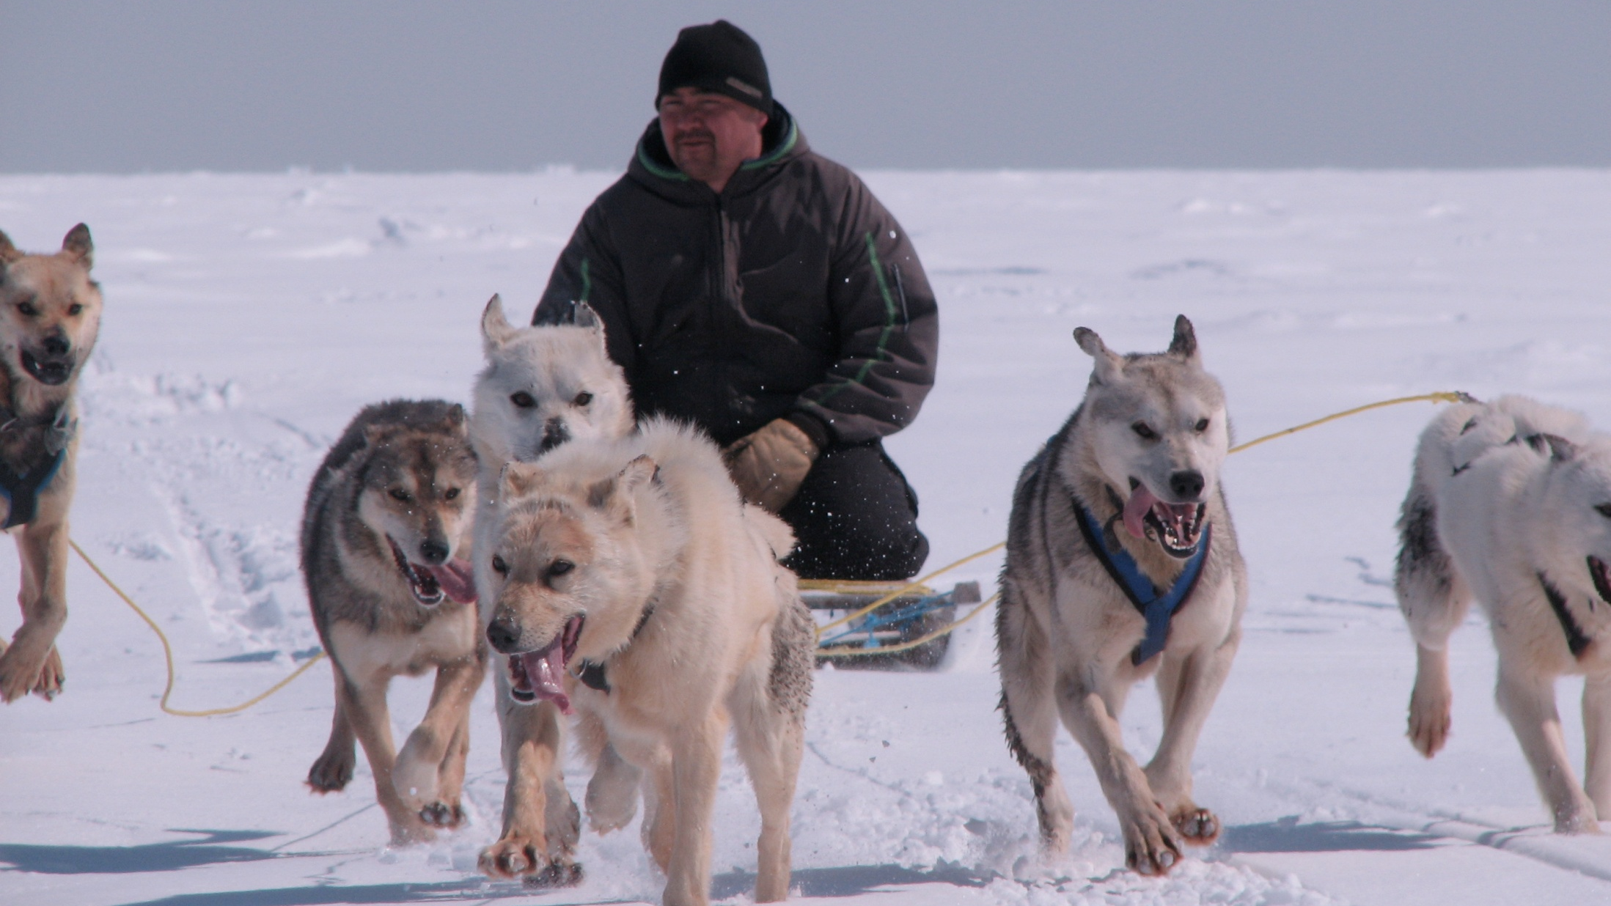
agile processes promote sustainable development. the sponsors, developers, and users should be able to maintain a constant pace indefinitely.

Slide 23
continuous attention to technical excellence and good design enhances agility.

Slide 24
simplicity--the art of maximizing the amount of work not done--is essential.

Slide 25
the best architectures, requirements, and designs emerge from self-organizing teams.

Slide 26
at regular intervals, the team reflects on how to become more effective, then tunes and adjusts its behaviour accordingly.

Slide 27
lean principles 1. eliminate waste

Slide 28
lean principles 2. amplify learning

Slide 29
lean principles 3. decide as late as possible

Slide 30
lean principles 4. deliver as fast as possible

Slide 31
lean principles 5. empower the team

Slide 32
lean principles 6. build integrity in

Slide 33
lean principles 7. see the whole

Slide 34
business change via sustained effort across the organisation
Change
Change
Change
Images shamelessly stolen from Ahmed Sidky (ICAgile)

Slide 35
workflow and project management aup, crystal clear, dsdm, kanban, rup, scrum

Slide 36
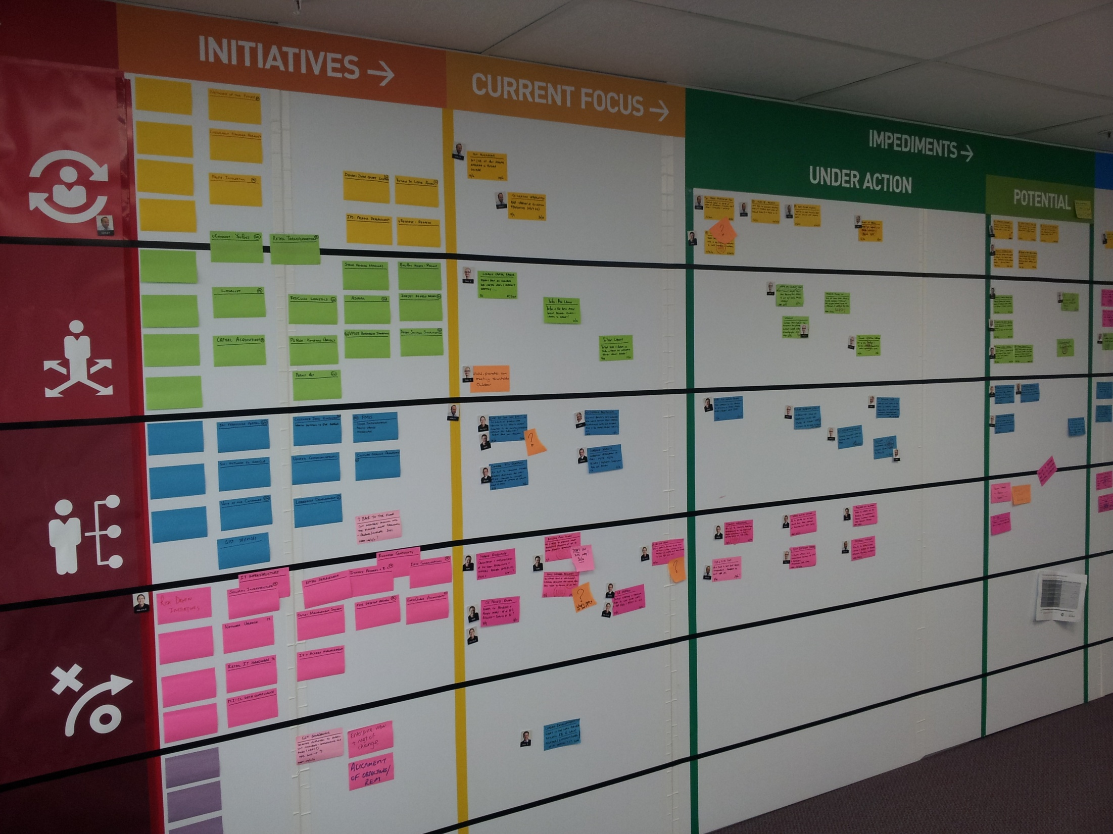
kanban 1. visualise (card wall) 2. limit wip 3. manage flow 4. make policies explicit 5. feedback loops 6. improve collaboratively

Slide 37
limit wip reduce lead time, identify blocks & clear bottlenecks

Slide 38
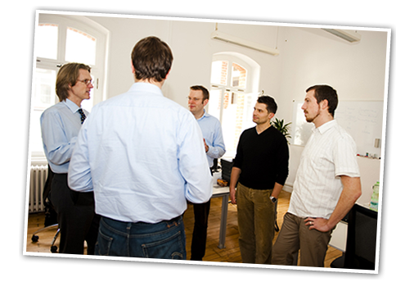
scrum * iterative product development * 1-4 week sprints * formal roles (product owner & scrum master) * timeboxed meetings

Slide 39
development methods bdd, fdd, rad, lean software, xp

Slide 40
extreme programming activities writing the software testing the software listening to the customer designing & refactoring development pair programming common code standards clear system metaphor

Slide 41
quality methods test driven development

Slide 42
test-driven development 1. create a test 2. add the test to the test catalogue 3. write the code 4. run the tests (all of them) 5. clean up the code as required. (refactor)

Slide 43
mura: unevenness muri: overburden muda: waste understanding waste

Slide 44
1. transportation the 7 wastes

Slide 45
2. inventory the 7 wastes

Slide 46
3. motion the 7 wastes

Slide 47
4. waiting the 7 wastes

Slide 48
5. over production the 7 wastes

Slide 49
6. over processing the 7 wastes

Slide 50
7. defects the 7 wastes

Slide 51
agile means no documentation common agile mistakes

Slide 52
not measuring, monitoring or correcting common agile mistakes

Slide 53
common agile mistakes assuming you can do more with less

Slide 54
common agile mistakes skimping on training and education

Slide 55
common agile mistakes lacking an executive sponsor

Slide 56
common agile mistakes thinking agile is faster or easy

Slide 57
start with a tool common agile mistakes

Slide 58
failing to scale common agile mistakes

Slide 59
assuming agile = scrum common agile mistakes

Slide 60
evan leybourn evan@theagiledirector.com questions???

Slide 61
lean, agile & kanban for software part 2: roles & responsibilities

Slide 62
Business
Technical
Users
Customer
Customer Representative
Team Facilitator
Developers
Testers

Slide 63
users will use the software, identify issues & provide feedback

Slide 64
users can be there are no typical users

Slide 65
users do not set scope or test work

Slide 66
customers will define, start& end the project

Slide 67
customers can be internal managers or external clients

Slide 68
customers do not direct work

Slide 69
the customer representative will manage the product backlog, set the scope & approve releases

Slide 70
the customer representative can be project manager, product manager or customer

Slide 71
the customer representative does not manage the team

Slide 72
the team facilitator will manage the agile process & report on progress

Slide 73
the team facilitator can be project manager, team leader or team member

Slide 74
the team facilitator does not prioritise features

Slide 75
developers will develop features, and resolve issues

Slide 76
developers can be developers, designers, writers, or administrators cross functional

Slide 77
developers do not prioritise features

Slide 78
testers will test, approve or reject features for release

Slide 79
testers can be existing developers or dedicated testers

Slide 80
testers do not test their own code

Slide 81
7 +/- 2 typical team size

Slide 82
has an interest in the work & is kept up to date involved parties (chickens)

Slide 83
committed parties (pigs) "do" the work & are responsible for the release

Slide 84
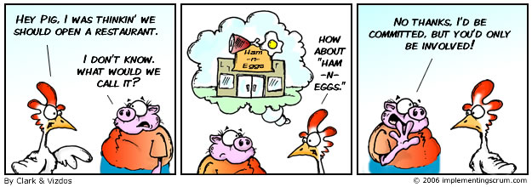

Slide 85
evan leybourn evan@theagiledirector.com questions???

Slide 86
lean, agile & kanban for software part 3: project initiation

Slide 87
value stream mapping defines the ‘as-is’ steps & roles for each task

Slide 88
value added time spent on outcomes for the customer

Slide 89
non-value added time spent between steps

Slide 90
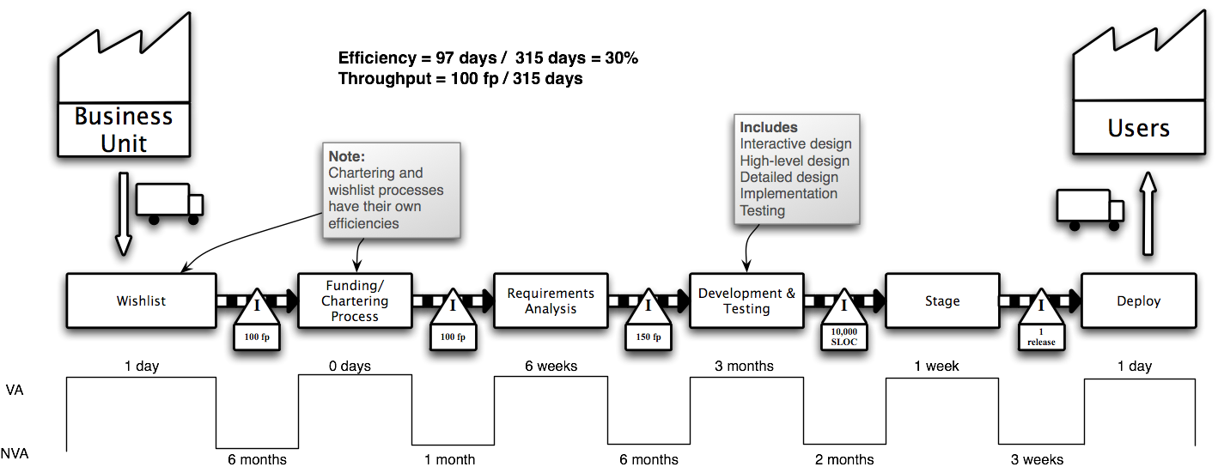
1. gather preliminary information 2. product quantity routing analysis 3. group customers and materials 4. sort product families by sequence 5. choose one value stream to start

Slide 91
6. create an operations flow chart 7. walk the shop floor 8. collect the data 9. construct the vsm 10. summarize the data to get the big picture

Slide 93
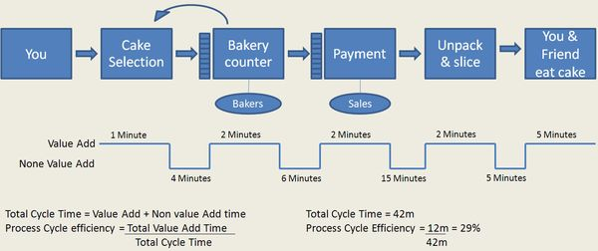

Slide 94
reduce risk & uncertainty by defining the high level scope

Slide 95
align to strategic goals, & technical frameworks skills gap analysis & recruitment

Slide 96
beginning the process agile projects have minimal initiation

Slide 97
the development team should be engaged during initiation

Slide 98
customer is fully aware of their responsibilities customers share accountability for delivery

Slide 99
“friends don’t let friends use microsoft project”

Slide 100
- “how much is this going to cost?” - “as much as you’re willing to spend.”

Slide 101
- “how long is this going to take?” - “as long as is necessary.”

Slide 102
- “what am i going to get?” - “whatever you tell us you want.”

Slide 103
work in priority order, release quickly & monitor cycle time fixed cost

Slide 104
work in priority order fixed time

Slide 105
fixed scope focus on backlog definition and estimation

Slide 106
fixed cost and time calculate total cost against cycle time

Slide 107
fixed cost and scope increase the estimate risk during initiation

Slide 108
fixed time and scope allocation additional time into the schedule

Slide 109
fixed cost, time and scope cancel the project

Slide 110
evan leybourn evan@theagiledirector.com questions???

Slide 111
lean, agile & kanban for software part 4: stories, tasks & the backlog

Slide 112
define user stories as a ... i need ... so i can ...

Slide 113
invest characteristics independent & self-contained

Slide 114
invest characteristics negotiable & flexible

Slide 115
invest characteristics valuable to the customer

Slide 116
invest characteristics estimatable and clearly defined

Slide 117
invest characteristics small – between ½ - 2 days

Slide 118
invest characteristics testable with defined qc metrics

Slide 119
create an ordered product backlog (in low detail) allow customers to slowly define their needs

Slide 120
High Priority
Low Priority
Summary
Estimate
Function
Detail
Acceptance Criteria
Summary
Estimate

Slide 121
estimate the product backlog first order estimate - using story points

Slide 122
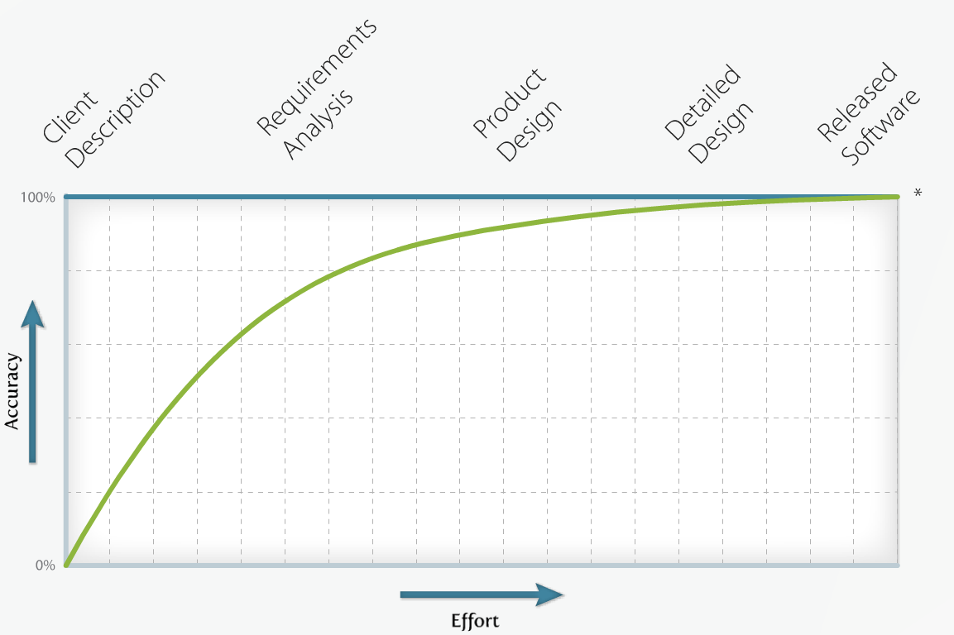

Slide 123
1, 2, 3, 5, 8, 13, 20, 40, 100 fibonacci sequence

Slide 124
expert opinion the team member with specific domain knowledge e.g. dba estimating database tasks

Slide 125
comparison comparing a task to another, estimated, task e.g. task a is about twice the effort of task b

Slide 126
components break a large task into small sub-tasks e.g. break user management into interface, login, access control, etc.

Slide 127
planning poker everyone plays a card representing their estimate everyone participates to reach consensus

Slide 128
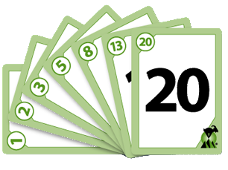
Estimates must not be mentioned during planning discussion to avoid anchoring

Slide 129
staff overhead: non project time estimated leave, illness, breaks, meetings etc. generic industry modifier: 25%

Slide 130
duration calculation story cost x (overhead + 1) x (estimate risk + 1) estimate risk is optional

Slide 131
for example 4 x (25% + 1) x (50%+ 1) = 4 x 1.25 x 1.5 = 5 to 7.5 hours

Slide 132
regularly review the backlog to ensure relevance

Slide 133
evan leybourn evan@theagiledirector.com questions???

Slide 134
lean, agile & kanban for software part 5: continuous delivery

Slide 135
Select user story
Determine tasks to deliver user story
Agree technical dependencies and order
Estimate the effort required to complete each task
Assess the risks associated with the task estimate
Assign the task

Slide 136
plan, design & estimate tasks technical specifications

Slide 137
Highest Priority Task
Test-Driven Development
Build
Commit
Continuous Integration
Done
Deploy
Testing

Slide 138
get highest priority feature allow developers to choose their tasks

Slide 139
test–driven development
1
Create a test
2
Add the test to the test catalogue
3
Write the code
4
Run the tests (all of them)
5
Clean up the code as required. (Refactor)

Slide 140
test coverage functions, boundary cases, user interface & performance

Slide 141
test types defect, usability, functionality & data

Slide 142
pair programming: coder + reviewer build

Slide 143
code standards: a common coding style build

Slide 144
system metaphor: clear naming standards build

Slide 145
regular commits version control

Slide 146
continuous build, testing & release continuous integration

Slide 147
5s: seiri / sort organise & clean the work area

Slide 148
5s: seiton / set in order arrange for easy identification and accessibility

Slide 149
5s: seiso / shine regular maintenance of the work area

Slide 150
5s: seiketsu / standardise a consistent approach to development

Slide 151
5s: shitsuke / sustain a commitment to maintain the previous 4s

Slide 152
what did you do yesterday? daily stand-up

Slide 153
what will you do today? daily stand-up

Slide 154
are there any issues? daily stand-up

Slide 155
summary stand-up for large teams

Slide 156
differs by organisation what does “done” mean?

Slide 157
definition of “done” documentation? uat? built / compiled?

Slide 158
what does “not done” mean? the primary measure of progress

Slide 159
per story or at fixed intervals deploy

Slide 160
present & review completed work to the customer regular review

Slide 161
evan leybourn evan@theagiledirector.com questions???

Slide 162
lean, agile & kanban for software part 6: kanban

Slide 163
kanban (かんばん) workflow monitoring & visualisation

Slide 164
can be as simple or complex as required the flow of value through the system

Slide 165
Backlog
Build
Test
Done

Slide 166
Backlog
Build
Test
Done
Analysis
Stage
Doc’
Release

Slide 167
tasks with upstream dependencies blocked

Slide 168
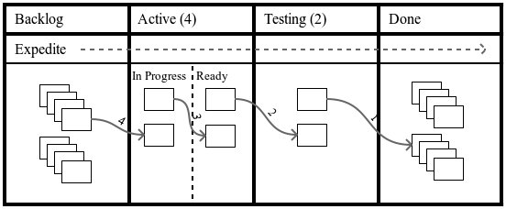

Slide 169
work in progress limit concurrent work and promote workflow

Slide 170
“pull” all ready tasks to wip limit pull!!!

Slide 171
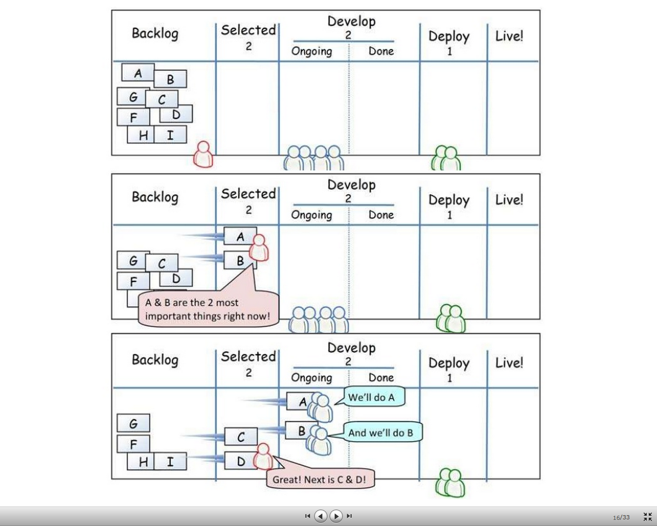

Slide 172
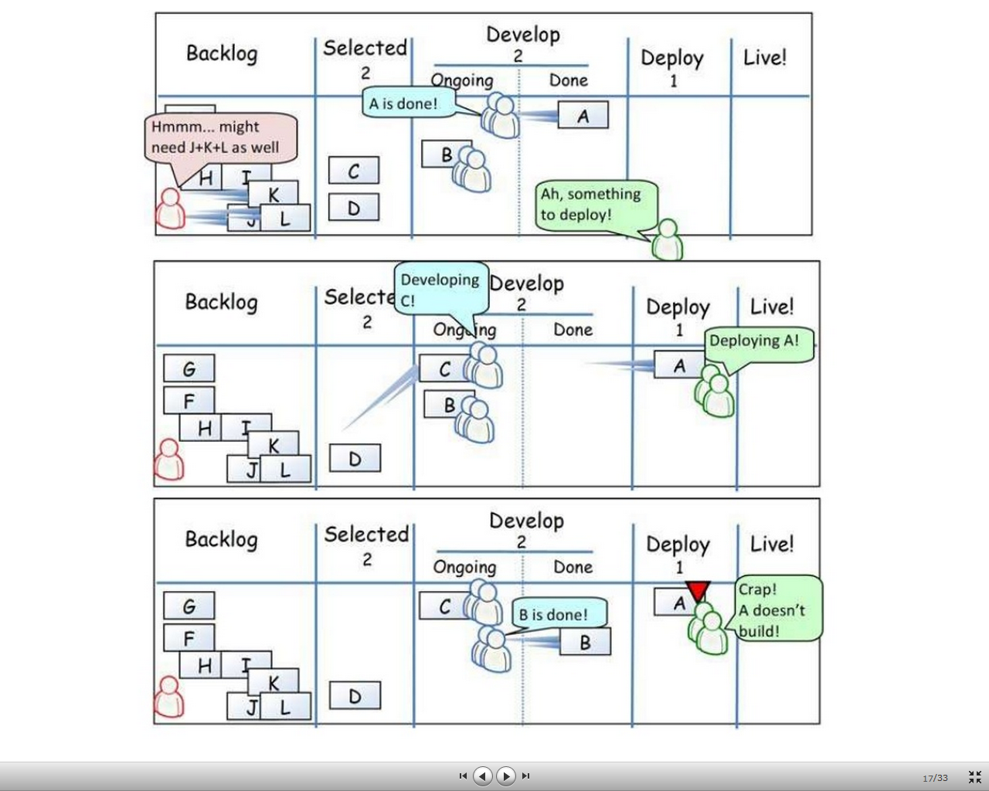

Slide 173
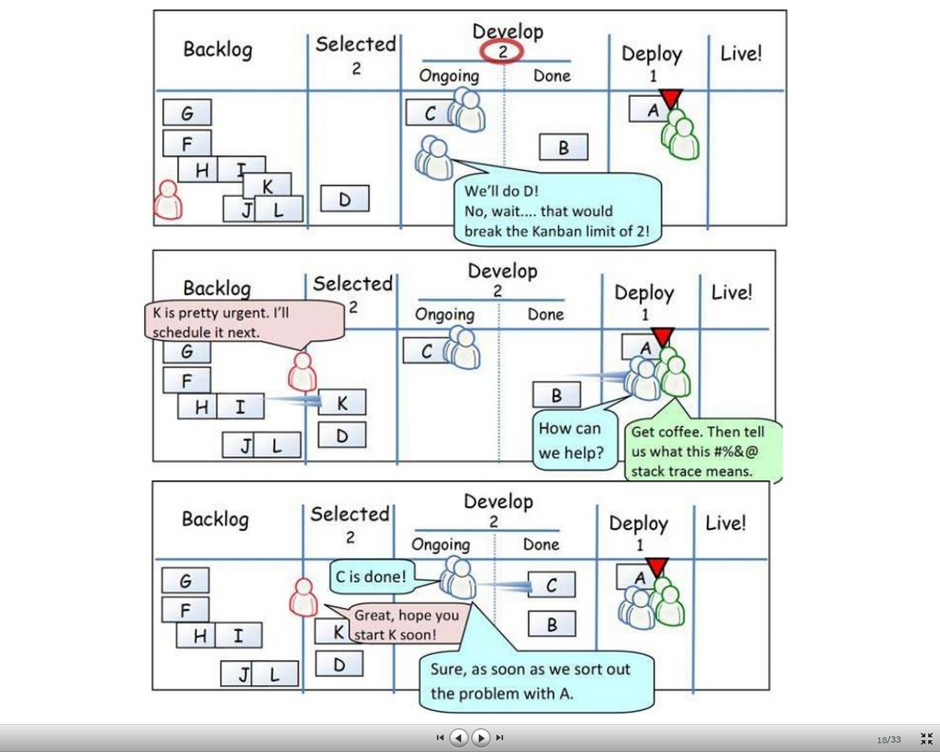

Slide 174
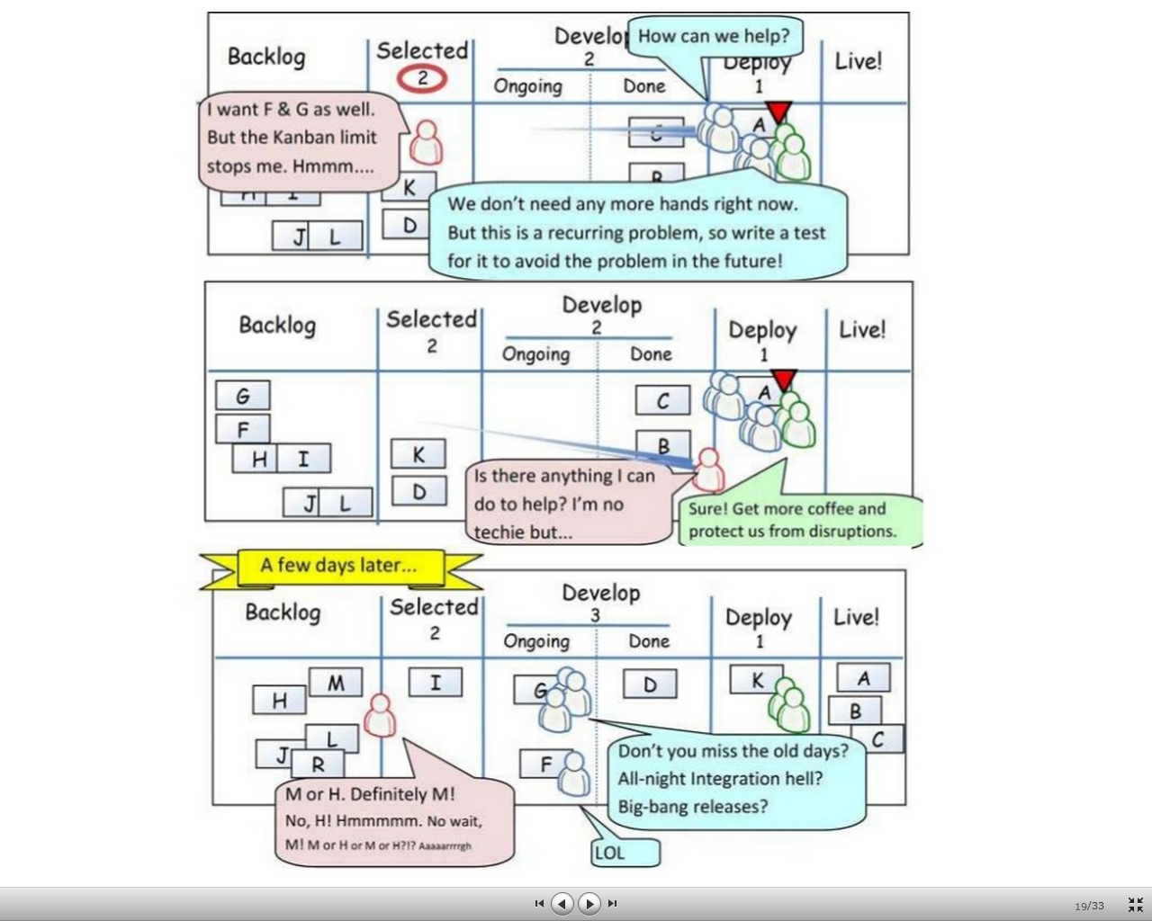

Slide 175
kanban: class of service * expedite * fixed delivery * standard class * intangible class

Slide 177
identify & resolve bottlenecks through low wip limits and strict process flow

Slide 178
production levelling constant rate of flow through all states

Slide 179
customers can always see progress promoting transparency

Slide 180
progress monitoring cumulative flow statistical run

Slide 181
cycle time average time to complete a task from start

Slide 182
lead time average time to complete a task from request

Slide 183
plot delivered functionality against duration effort visualisation

Slide 184
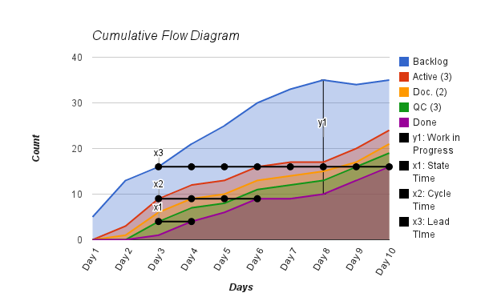
cumulative flow diagram

Slide 185
don't manage by numbers identify problem trends early

Slide 186
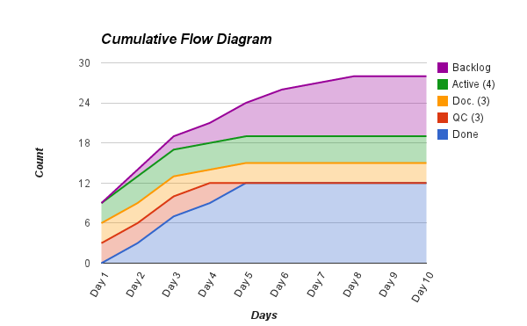
bottleneck

Slide 187
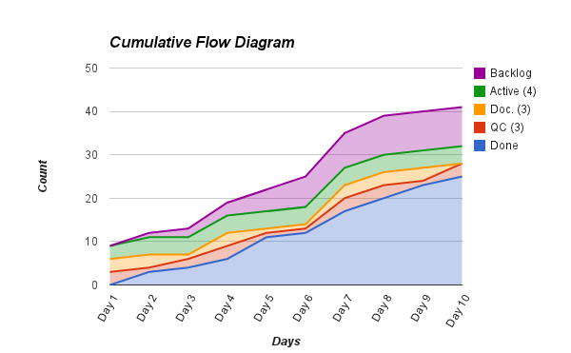
poor flow

Slide 188
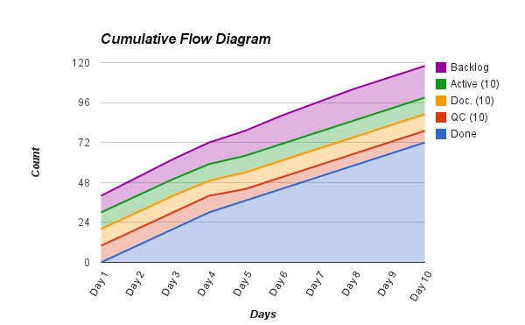
large wip

Slide 189
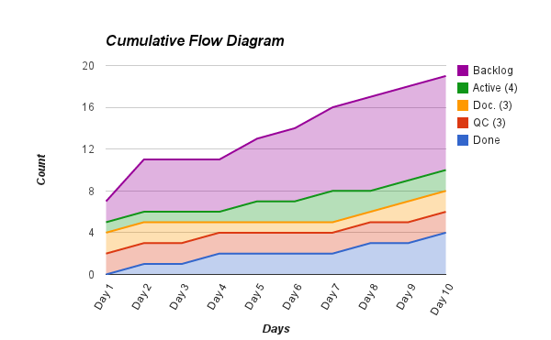
long lead time

Slide 190
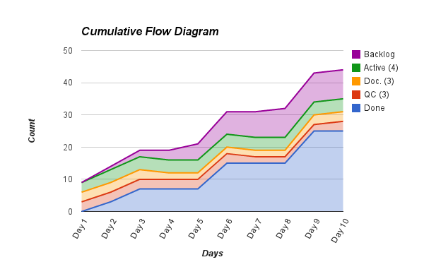
plateau

Slide 191
plot cycle time against average duration visualisation

Slide 192
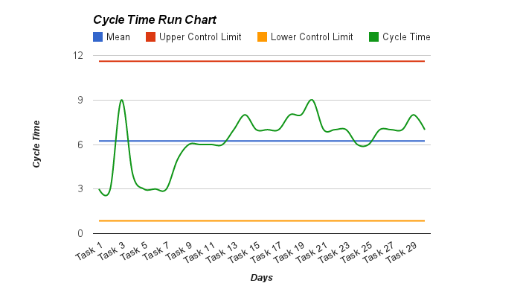
cycle time run charts

Slide 193
don't manage by numbers identify problem trends early

Slide 194
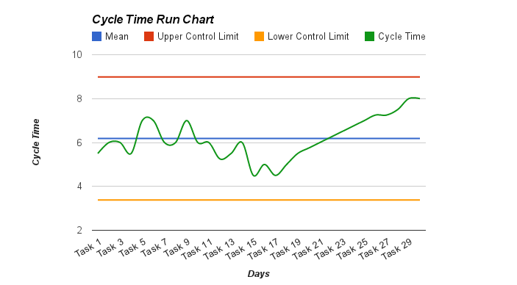
process trend

Slide 195
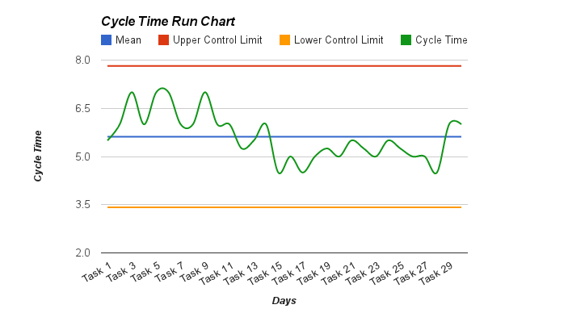
process shift

Slide 196
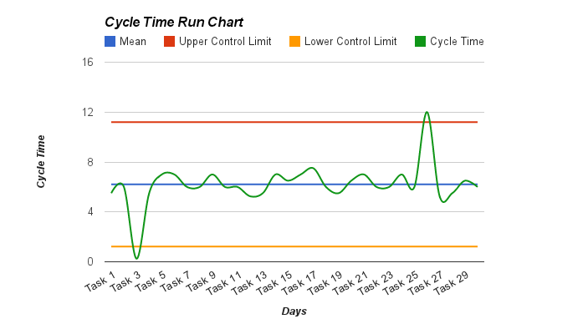
extreme process variation

Slide 197
evan leybourn evan@theagiledirector.com questions???

Slide 198
lean, agile & kanban for software part 8: kaizen (改善)

Slide 199
inspect & adapt continuous improvement

Slide 200
what went well? retrospective / quality circle

Slide 201
add actionable tasks to the backlog what could be improved?

Slide 202
kaizen emphasises teamwork, discipline & morale

Slide 203
1. do not send defective products to the subsequent process 2. the subsequent process comes to withdraw only what is needed 3. produce only the exact quantity withdrawn by the subsequent process 4. equalise, or level, the production 5. kanban is a means to fine tuning 6. stabilize and rationalize the process

Slide 204
http://agilebusinessmanagement.org - Case Studies - Articles - Community Join our Agile Journey
Notes:
Let’s finish off by looking at our original definition of business growth; Business growth comes from applying profitability to customer growth. Profitability comes from delivering services to your customers, accurately and efficiently. Over the last 15 minutes we have looked at some of the mechanisms from the lean and agile traditions that we can apply for adaptable businesses and sustainable business growth.
And I’ll leave you on that note. Any questions.

Slide 205
To learn more, check out Directing the Agile Organisation by Evan Leybourn available at Amazon and all good book stores

